Slide 1
Containerization: Application Deployment
A comprehensive look at containerization technologies, benefits, and applications.

Slide 2
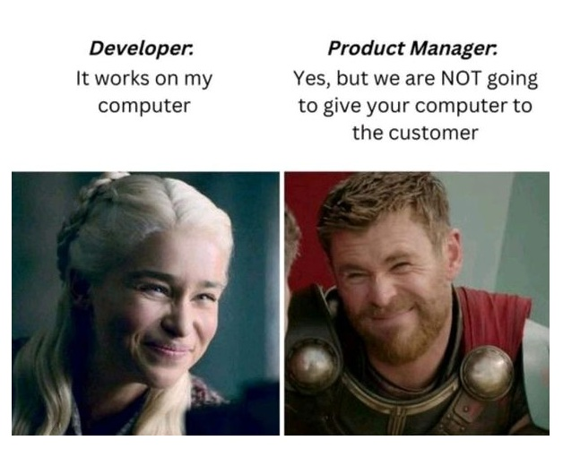

Slide 3
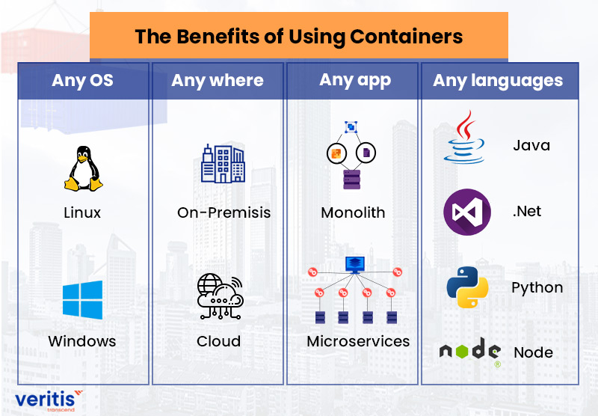

Slide 4
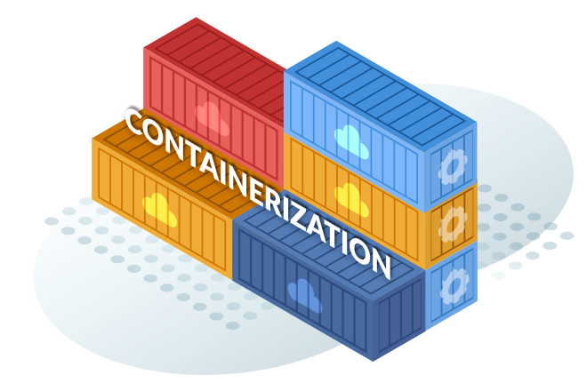
Introduction to Containerization
Containerization is a lightweight virtualization method where applications and their dependencies are packaged together into containers, ensuring consistency across environments.
Key Features:
Lightweight compared to virtual machines.
Portable and consistent.
Isolated environments for applications.

Slide 5
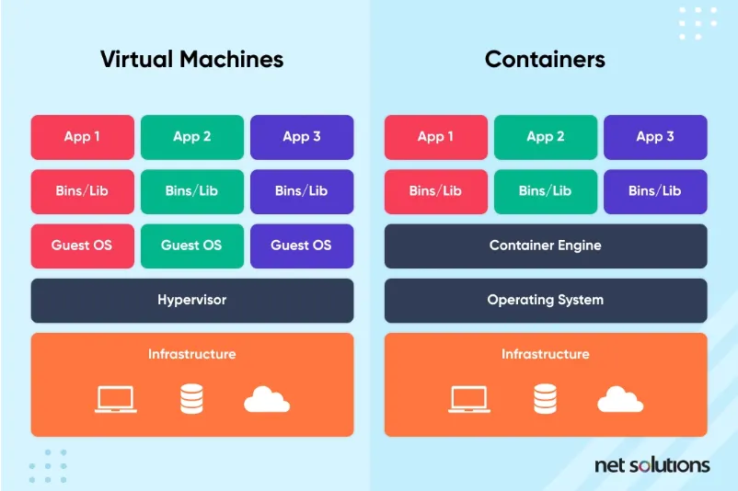

Slide 6
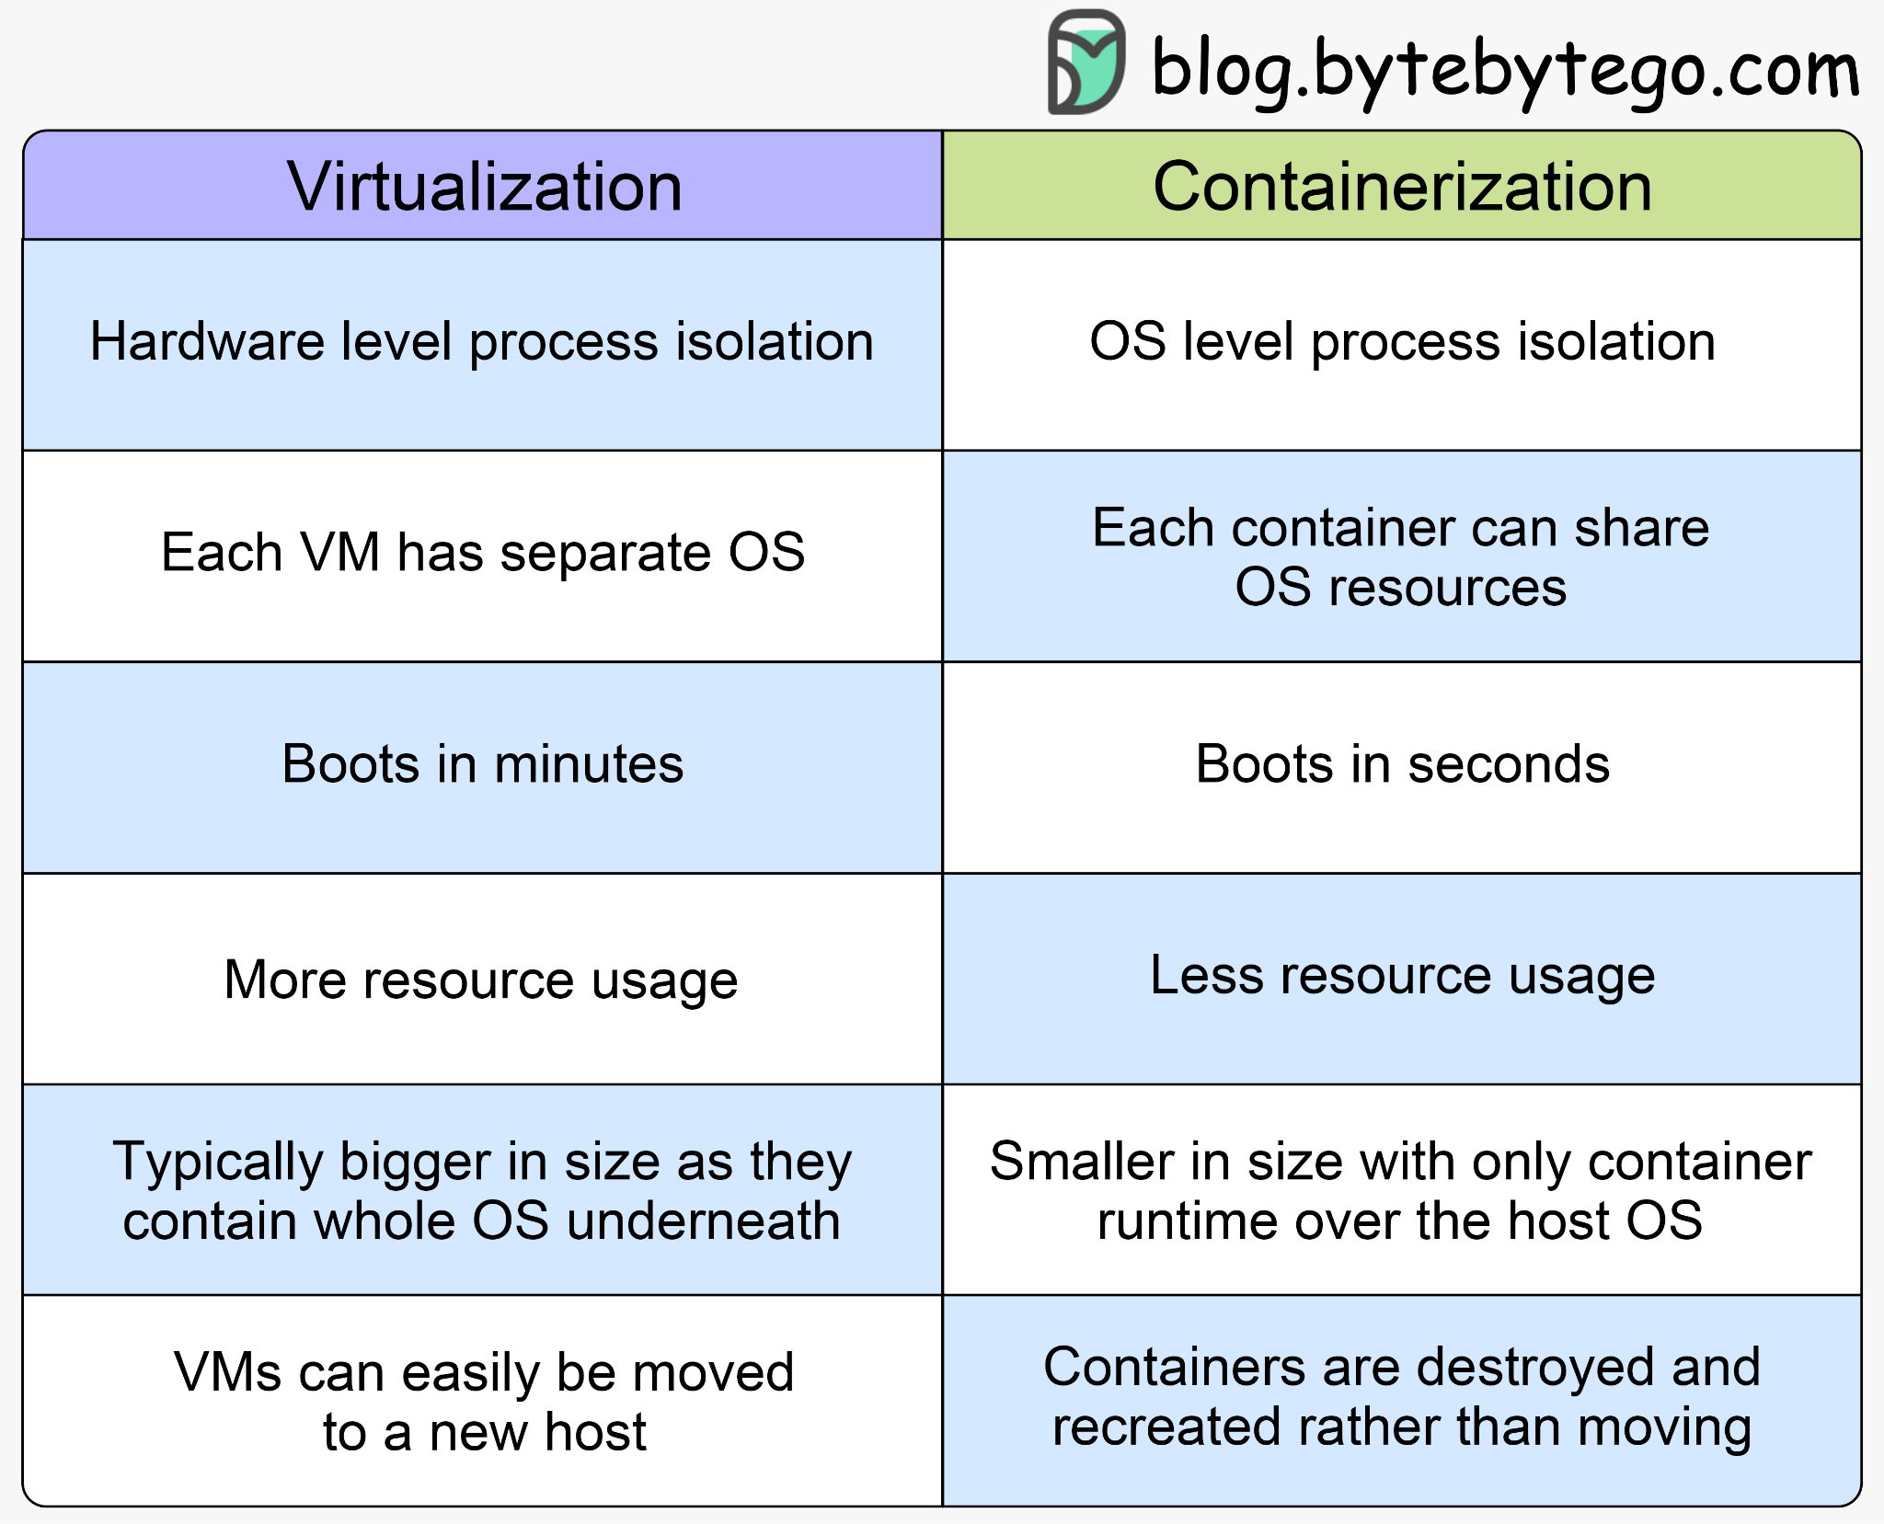
Virtualization and Containerization

Slide 7
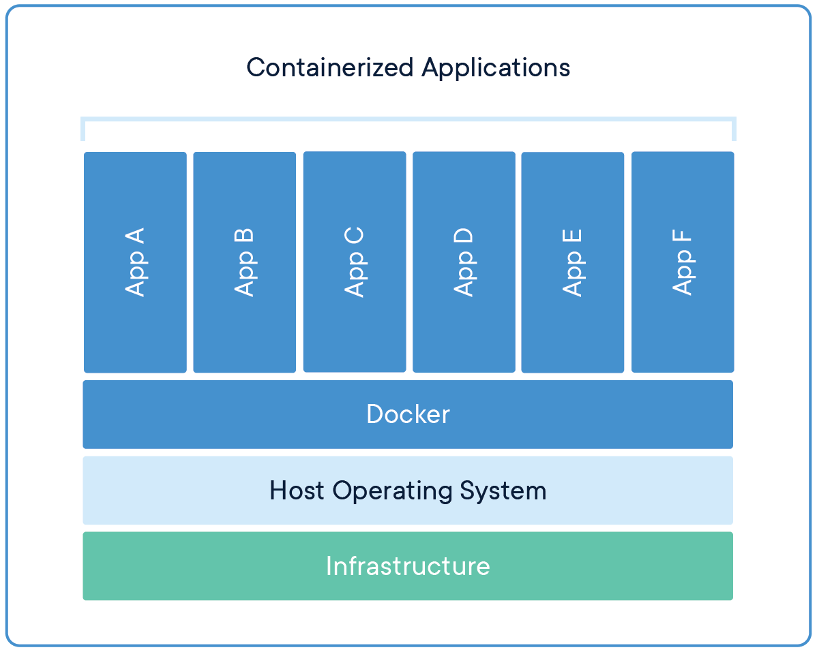
How Containers Work
Core Components:
Container Engine: Manages and runs containers (e.g., Docker Engine).
Container Image: A lightweight, standalone executable package containing everything needed to run an application.
Orchestration Tools: Manage large-scale container deployments (e.g., Kubernetes).
Comparison with Virtual Machines:
Containers share the host OS kernel, while VMs include a full OS.
Containers are faster and more efficient.

Slide 8
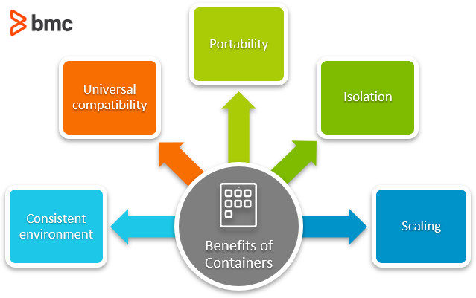
Benefits of Containerization
Portability: Consistent behavior across development, testing, and production environments.
Efficiency: Uses fewer resources than traditional VMs.
Scalability: Easy to scale applications horizontally.
Isolation: Secure and independent runtime environments.
Rapid Deployment: Faster builds, testing, and deployments.

Slide 9
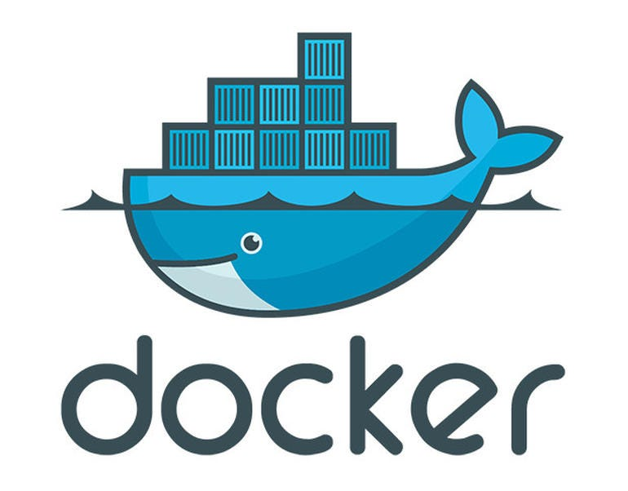
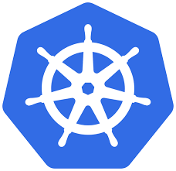
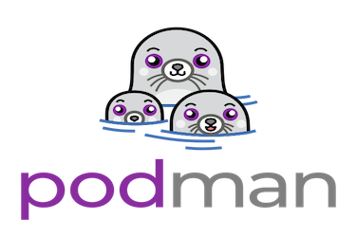
Popular Containerization Tools
Docker:
Most widely used containerization platform.
Easy image creation and management.
Kubernetes:
Orchestrates containerized applications.
Manages scaling, networking, and distribution.
Podman:
Docker-compatible but daemonless.(No BGP)
Focuses on security.

Slide 10
Real-World Use Cases
Microservices Architecture: Breaking monolithic apps into smaller, manageable services.
CI/CD Pipelines: Containerized builds for consistency.
Hybrid Cloud Deployments: Seamlessly migrate workloads between cloud providers.

Slide 11
Challenges of Containerization
Security Concerns: Vulnerabilities in shared host OS.
Learning Curve: Requires understanding of tools like Docker/Kubernetes.
Resource Management: Monitoring and limiting resource use.
Compatibility Issues: Legacy systems may not support containers.

Slide 12
Future of Containerization
Emerging Tools: Alternatives like Podman, CRI-O.
Trends:
Serverless computing leveraging containers.
Edge computing with containerized apps.
Predictions: Greater adoption in IoT and AI workloads.

Slide 13


Slide 14
Summary
Recap of key points:
Lightweight and portable applications.
Key tools: Docker and Kubernetes.
Real-world applications in microservices and CI/CD.

